Slide 1
BOOK MANAGEMENT
Hữu Tuấn - Phương Nhung
PNV 20 A

Slide 2



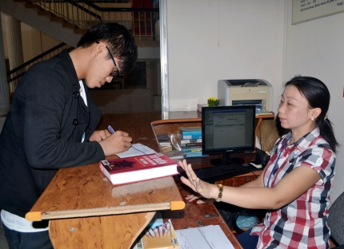

DAILY DIFFICULTIES
Books management
Update return date
borrowing and return
management
Take time to search

Slide 3
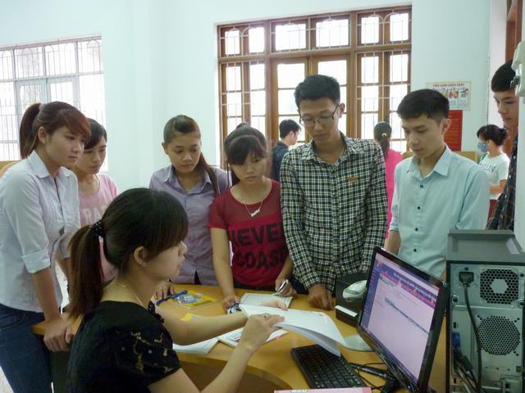




Introduce
Lend books
Reader Manage
Return Book
See information and
add new books
Search Books
BOOKS MANAGEMENT

Slide 4
OBJECTIVE
Save time, easy to manage.
Manage books information in detail and efficiency.
Book information is updated daily.
Make loan books easy.
Detailed management and clear reader information.
Return books easy and fast.
Intelligent and accurate book search.

Slide 5


Slide 6


